Slide 1
Mouse Brain Slice
Reorientation Pipeline

Slide 2
Core Pipeline Design
01
02
03
04
05
Load & Normalise
Tissue Mask
Atlas Match
PCA Rotation
Flip Resolve
PNG / TIFF / CZI → float32 [0,1]. Polarity detection: compare central vs corner medians to determine if tissue is bright or dark.
Li threshold (fallback Otsu), morphological closing, fill holes. Keep up to 3 largest connected components.
15–25 candidate atlas slices per axis. Fast NCC pre-screen → top-3 → full per-rotation NCC. Return best-matching atlas slice.
Score each 90° rotation: 0.7 × cos(PCA angle residual) + 0.3 × NCC. Winner recorded with NCC margin over 2nd-best.
Coronal/axial: test none / lr / ud / both flips against atlas via NCC. Sagittal: geometric olfactory-bulb landmark (see next slide).

Slide 3
Sagittal Flip Resolution
The Problem
Geometric Landmark: Olfactory Bulb
1.
Sagittal slices are near-bilaterally symmetric. A left-hemisphere and right-hemisphere slice produce almost identical NCC scores against the same average atlas.
Flipping left↔right changes little in intensity — the atlas carries no strong laterality signal.
Result: NCC-based flip resolution is unreliable for sagittal views.
Extract contour (cv2.findContours) from tissue mask.
2.
Compute convex hull → convexityDefects → find the deepest indentation point (deepest_pt) between hull and contour.
3.
Score = (max_defect_depth / max(H,W)) × (dx × dy)
where dx, dy are normalised coordinates of deepest_pt.
4.
Rationale: after correct PCA rotation the olfactory bulb sits at the bottom-right corner. So the deepest concavity should land bottom-right. high dx AND high dy → large score.
5.
Test four orientations: none / rot180 / lr / rot180+lr. Highest score wins.

Slide 4
Results — Quantitative Metrics
Coronal
Sagittal
Axial
Overall
0.843
0.775
0.884
0.834
Dice
Dice
Dice
Dice
HD 0.103 NCC 0.572
HD 0.171 NCC 0.435
HD 0.063 NCC 0.775
HD 0.112 NCC 0.594
Axis
n
Dice ↑
HD_norm ↓
NCC ↑
Latency (ms)
Coronal
24
0.843
0.103
0.572
~183
Sagittal
24
0.775
0.171
0.435
~173
Axial
24
0.884
0.063
0.775
~193
Overall
72
0.834
0.112
0.594
~183

Slide 5
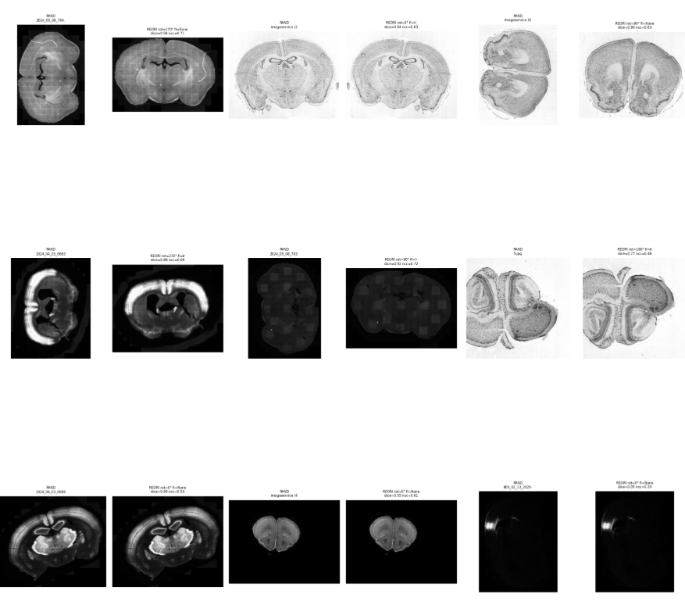
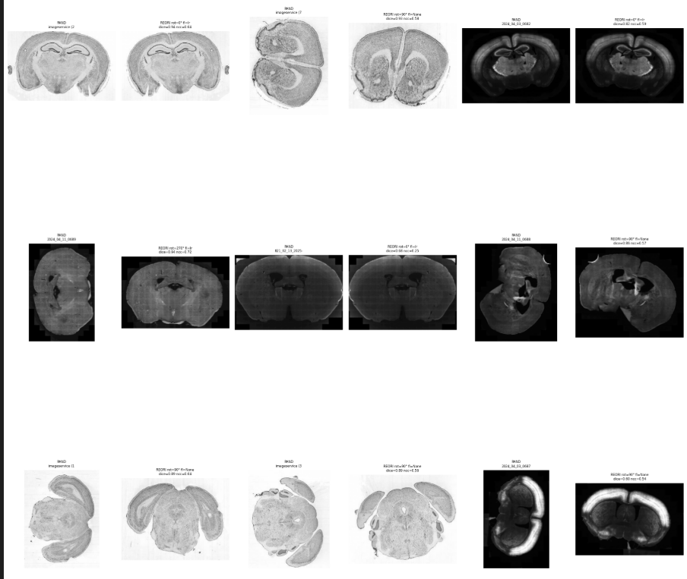
Results Grid — Coronal

Slide 6
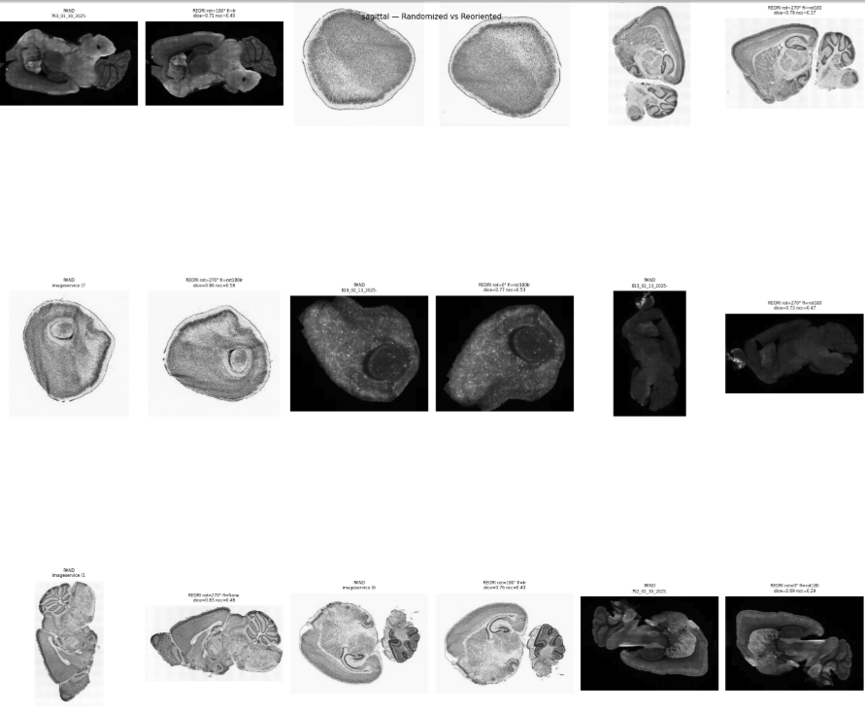
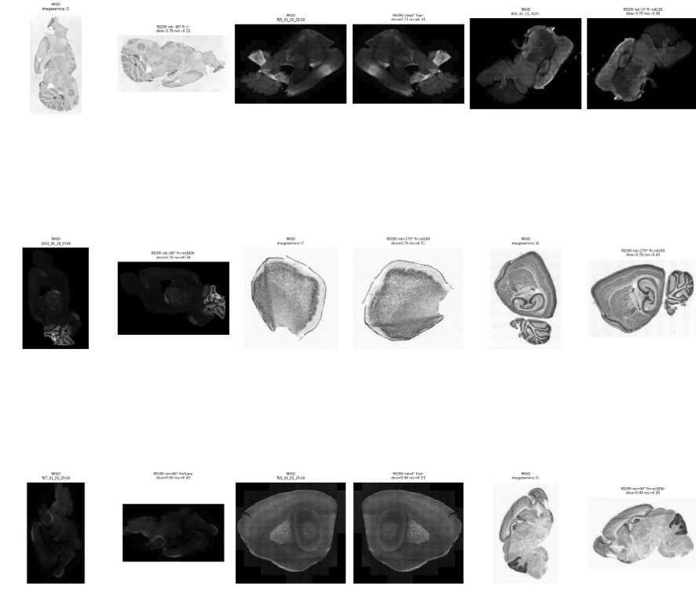
Results Grid — Sagittal

Slide 7
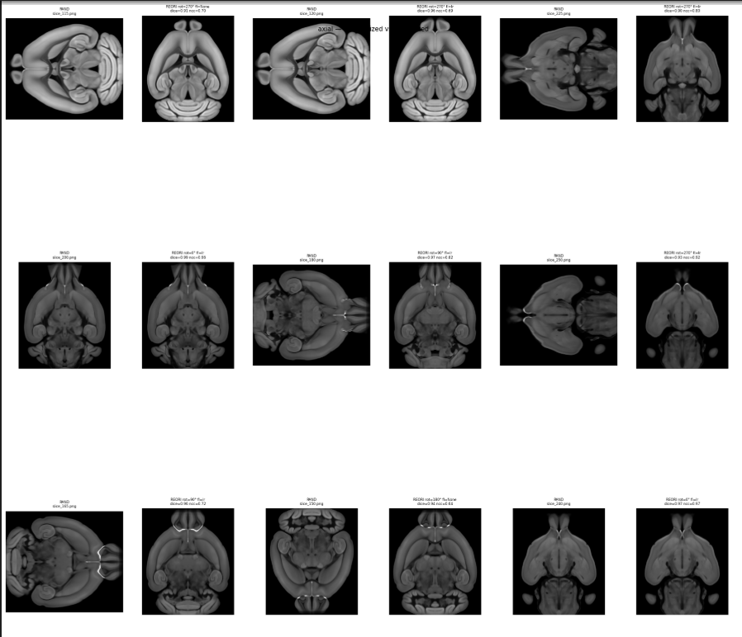
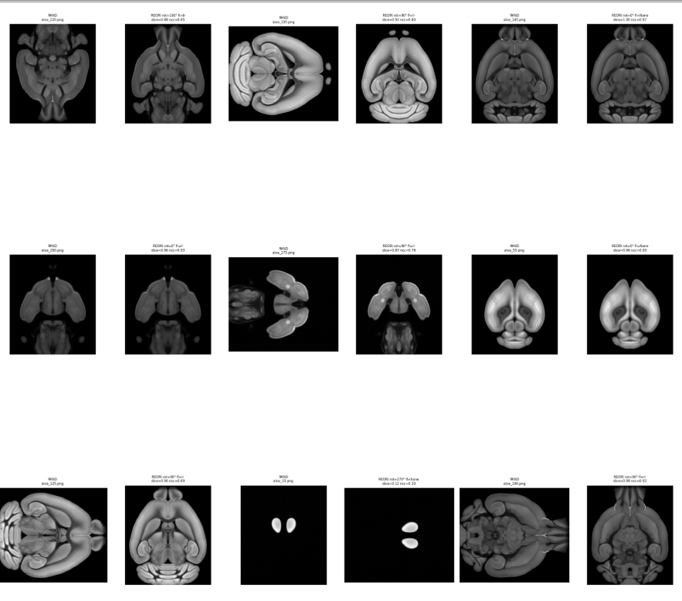
Results Grid — Axial

